Slide 1
NOVA/GMU ASPRS MAPATHON AGENDA
9:00 – 9:30: Brief Introduction to Open Street Map, Humanitarian Mapping
9:30 – 10:30: OSM Accounts and tutorial
10:30 – 11:00: Break
11:00 – Noon: MAPPING!!
Noon – 1pm: Lunch and Follow-up Activities

Slide 2
What is OpenStreetMap?
OpenStreetMap (OSM) is an internet project devoted to creating a map of the entire world
It is free for anyone to use.
The map is made entirely by volunteers who use GPS, aerial imagery, and open-source software to add information to the worldwide map.
WIKIPEDIA OF MAPS
Source: https://github.com/hotosm/learnosm/wiki/English-Teaching-Guides

Slide 3
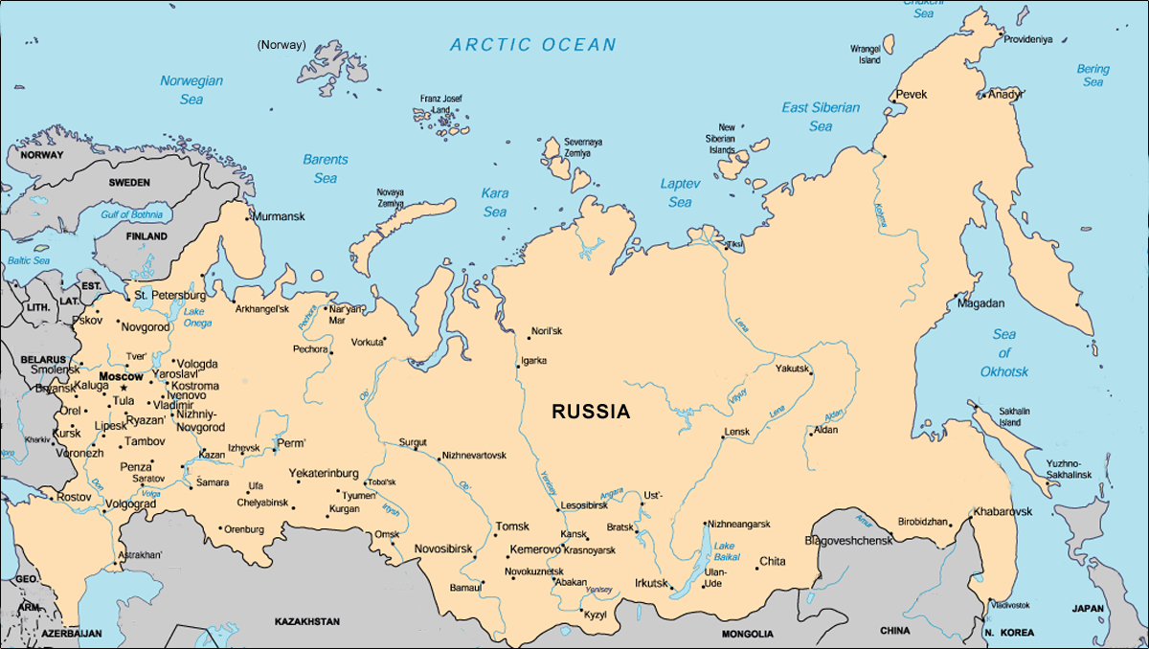
OSM RUSSIA 2007-2012 EDITS from ITO World
http://vimeo.com/53688271

Slide 4
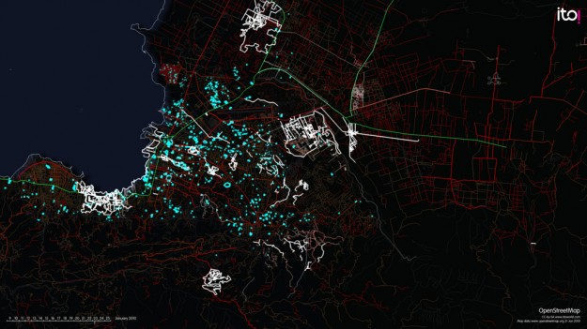
WHY IS OSM IMP?- HAITI from ITO World
http://vimeo.com/9182869
Notes:
A visualisation of the response to the earthquake by the OpenStreetMap community. 640 mappers made 1.4 million edits in 25 days- which takes a full year for 1 cartographer. Over the following days a large number of additions to the map are made with many roads (green primary, red secondary) added. Also many other features were added such as the blue glowing refugee camps that emerge. A lot of these edits were made possible by a number of satellite and aerial imagery passes in the days after the quake, that were release to the public for tracing and analysis.

Slide 5
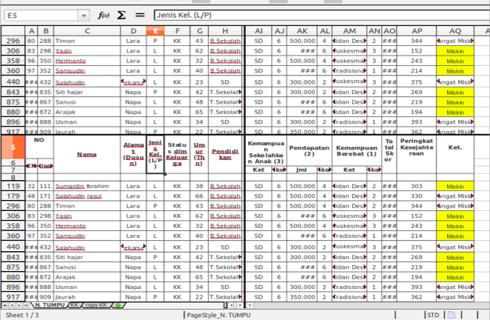
Source: https://github.com/hotosm/learnosm/wiki/English-Teaching-Guides
Notes:
Data is often stored in a spreadsheet, a database, or just written down on paper. Regardless of the method, it is a systematic way of keeping information.

Slide 6
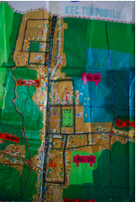
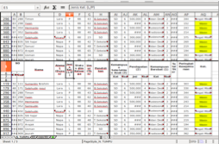
+
=
Source: https://github.com/hotosm/learnosm/wiki/English-Teaching-Guides
Notes:
Connecting geographic information - location information - to data, helps us to better use that data in the real world, since it is all relevant to physical space, and we want to better understand how it impacts our communities. By tying together geography and data, we're become better informed, and are better able to accurately convey reality.

Slide 7
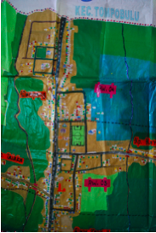
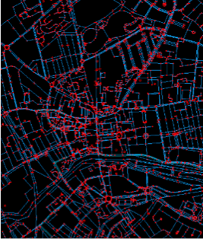
Going Digital
Source: https://github.com/hotosm/learnosm/wiki/English-Teaching-Guides
Notes:
First, we can do a lot more with our data and our maps if it is digital. By using the power of computers we can have more powerful tools to understand information, and it is much easier to share. Digital data can be easily shared and manipulated for different purposes. And drawing a map on a computer is not all that different from drawing a map on paper.

Slide 8
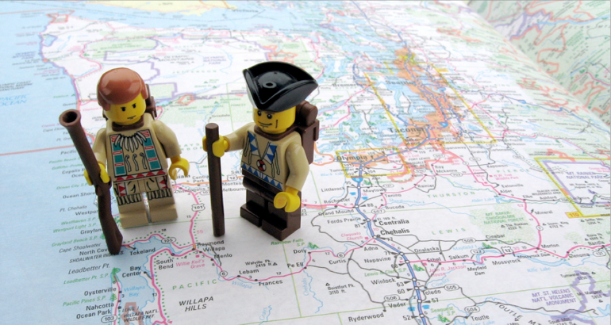
Source: https://github.com/hotosm/learnosm/wiki/English-Teaching-Guides
Image: http://segrev.wordpress.com/2011/04/28/704/
Notes:
The idea of OpenStreetMap is that people from all over the world can create digital maps of their communities, and save all of that data on one shared database. They can keep the information up to date and use it however they want. Imagine a map of the whole world printed on a big piece of paper. OSM allows anyone to tear of a little piece of that map, make it better, and then put the improved version back onto the big world map.

Slide 9
FOOD SECURITY AND MAPPING
Why farmers markets?
ECONOMIC: Helps local communities
HEALTH: Food tastes better, less chemicals
ENVIRONMENTAL: Less fuel used to get food to consumers

Slide 10
MAPPING LINGO
Tags: A label to describe a feature
Features: Physical features of a map (roads, buildings, etc)
Digitize: Convert data to digital form
GIS: Geographic Information System
OSM: Open Street Map
Mapgive: part of U.S. Department of State’s Humanitarian Information Unit. Aims to build an army of “digital humanitarians” by educating on the importance of mapping.
HOTSM: Humanitarian Open Street Map Team (facilitates collaboration between OSM and humanitarian responders)
ABC’s of GIS (from ESRI GIS Dictionary):
Point: A pair of coordinates (bus stop, fire hydrant, building) See next slide
Line: Connected series of coordinate pairs (path, street, driveway, crosswalk)
Polygon: Shape defined by a connected sequence of coordinate pairs 1st and last are the same (building, body of water, parking lot)
Commit message: Brief, but descriptive sentence on what features you entered. Additionally add #OSMGEOWEEK #GisNova to your description.

Slide 11
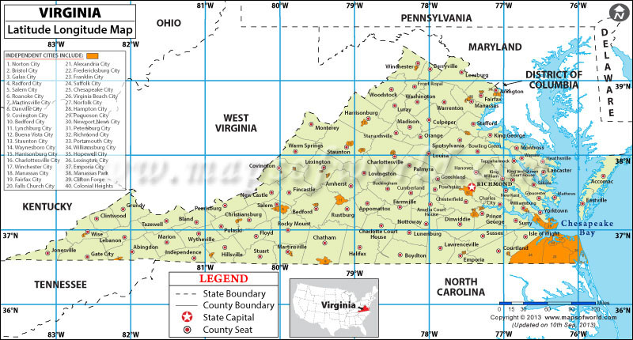
Source: mapsofworld.com
Notes:
Added to illustrate long, lat to help explain the definitions in the previous slide for point, line and polygon.

Slide 12
TAGGING
TAGGING: refers to the practice of assigning attributes to the map features you digitize.
Two parts:
Key: General level classifier
EXAMPLE: Shop
Value: More specific classification
EXAMPLE: Supermarket
Shop=Supermarket
Source: http://osmgeoweek.org/plan/tags/

Slide 13
IMPORTANT LINKS
Open Street Map: http://www.openstreetmap.org
Open Street Map Wiki: http://wiki.openstreetmap.org/wiki/Main_Page
Food Security Tags: http://wiki.openstreetmap.org/wiki/Food_security
Field Papers: http://fieldpapers.org/
Farmers Markets Data USDA:
http://search.ams.usda.gov/farmersmarkets/Accessible.aspx
MapGive: http://mapgive.state.gov/
Geo Coder: http://geocoder.us/
Penn State Geospatial Revolution videos: http://geospatialrevolution.psu.edu/
Haiti and OSM video: http://www.youtube.com/watch?v=pVCC2CB281M
MappingDC: mailing list - https://groups.google.com/d/forum/mappingdc
meetup - http://www.meetup.com/MappingDC/
twitter - https://twitter.com/mappingdc

Slide 14
OSM GUIDE
NEVER COPY ESPECIALLY FROM GOOGLE
USE MOZILLA FIREFOX OR CHROME NOT INTERNET EXPLORER
OPEN OSM WIKI FOR HELP
SAVE OFTEN; BE DESCRIPTIVE IN YOUR COMMIT MESSAGE
YOU CAN MAP ANYTHING THAT INTERESTS YOU!
BUT IF YOU AREN’T SURE, DON’T MAP IT!

Slide 15
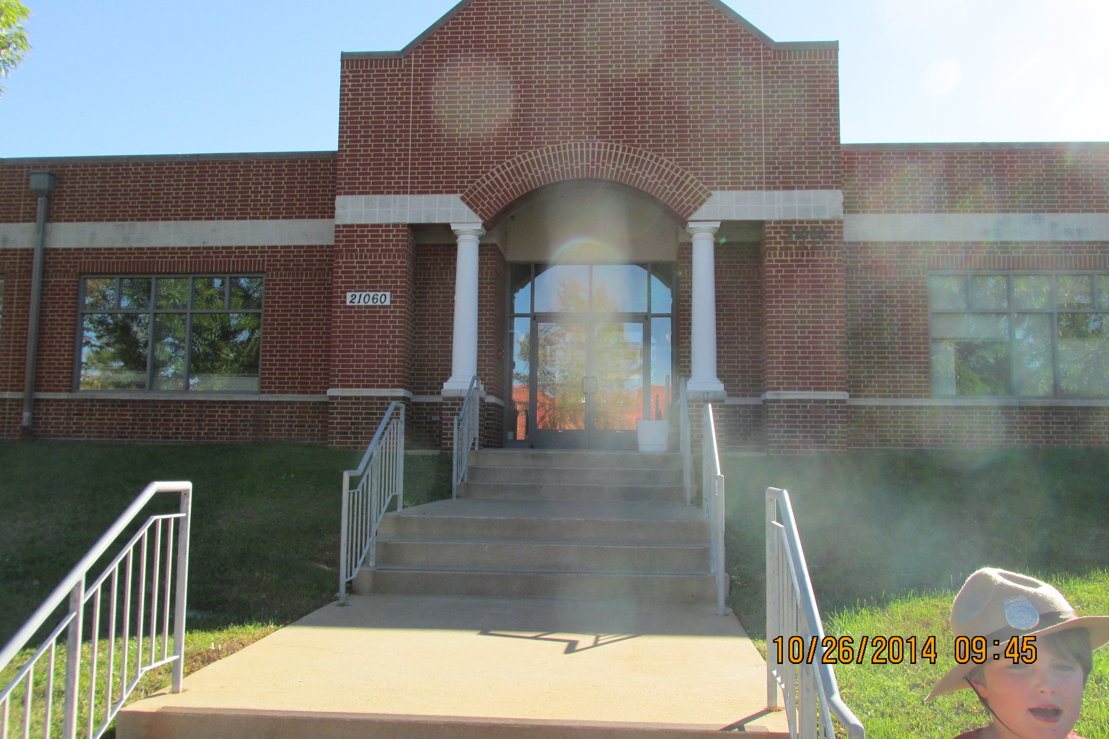
GET OUTSIDE AND EXPLORE: FIELD PAPERS
http://fieldpapers.org/

Slide 16
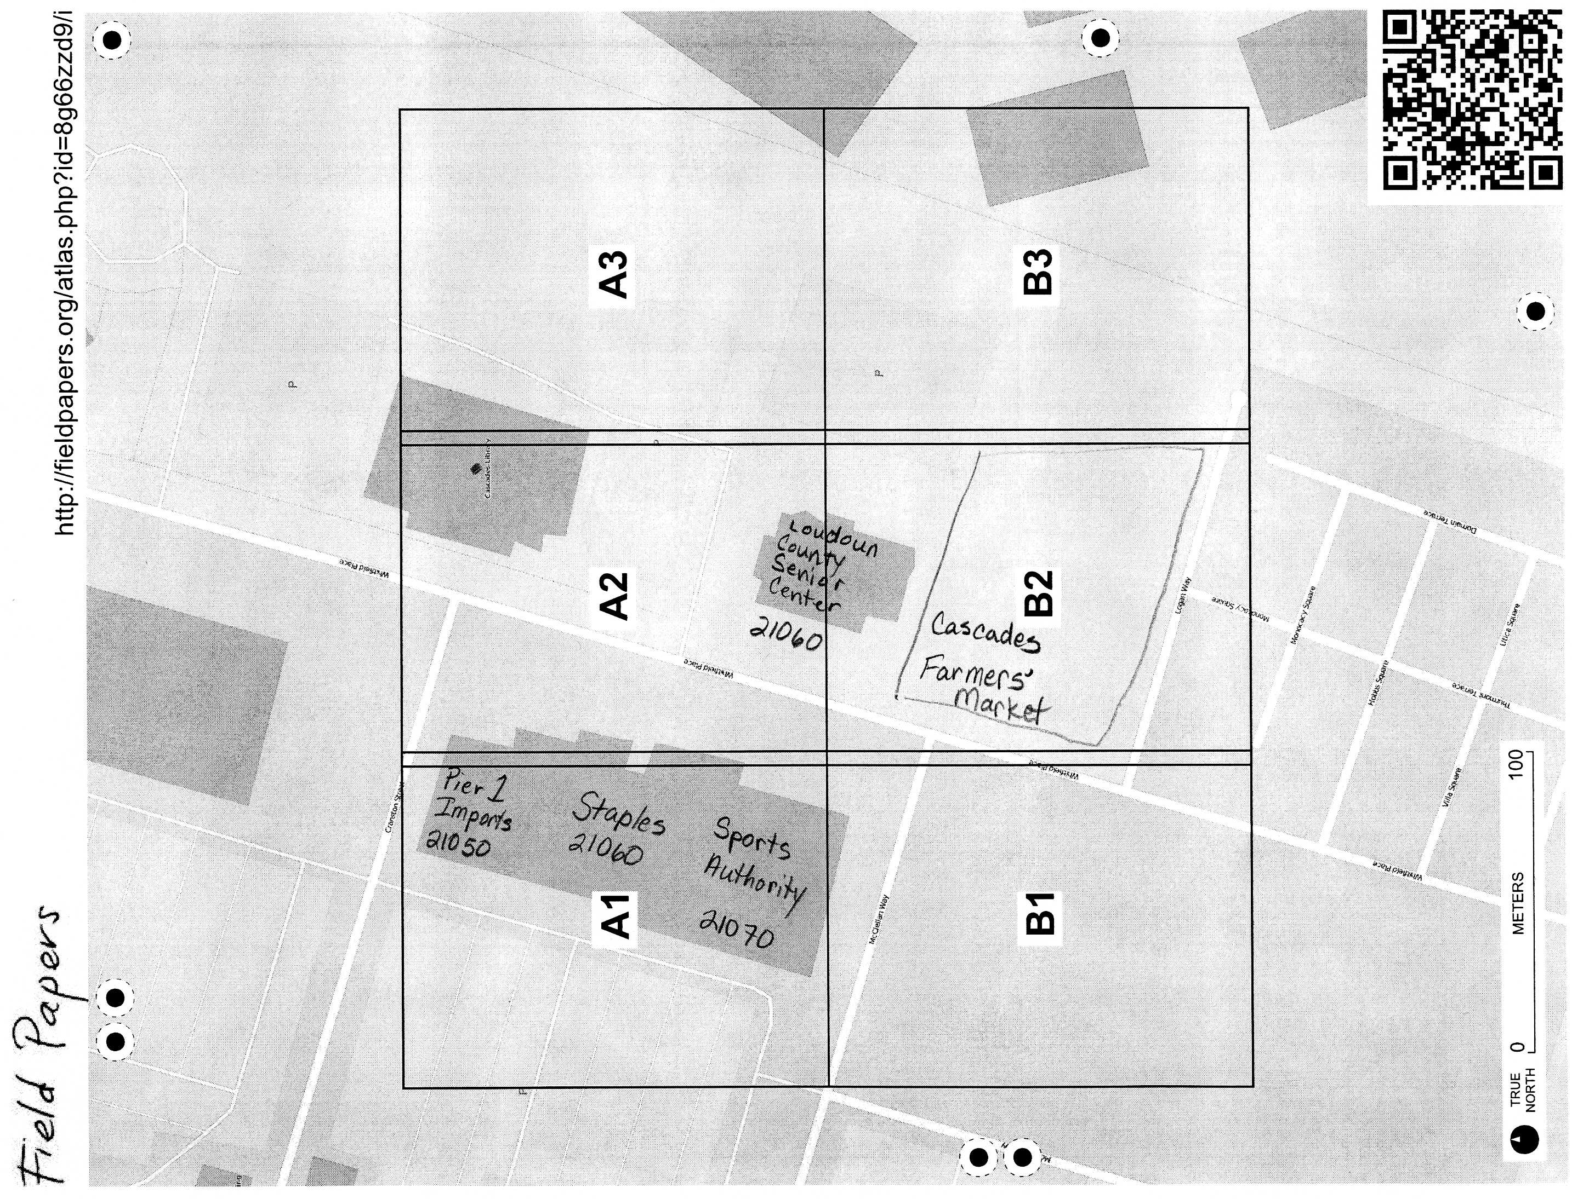
GET OUTSIDE AND EXPLORE: FIELD PAPERS

Slide 17
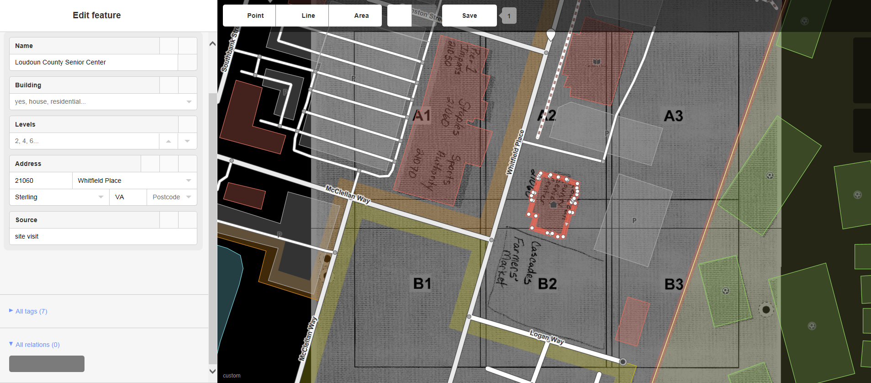
GET OUTSIDE AND EXPLORE: FIELD PAPERS
On site observations:

Slide 18
OSM TRAINING
Create an account: www.openstreetmap.org
Once you have created an account, type in your zipcode.
Create a point on the map: find your local grocery store and add a point.
Create an area on the map: draw a polygon around your store.
Create a line on the map: find your house and draw in your driveway.

Slide 19
HOW TO MAP A FARMERS MARKET
Download data (GIS Day 2014): www.nvcc.edu/home/mkrimmer
LOCATE FARMERS MARKET
http://www.screencast.com/t/JhacSWcE
TAG FARMERS MARKET
http://www.screencast.com/t/Y9jmxFHWxlB
SAVE FARMERS MARKET
http://www.screencast.com/t/7j6LcqBqE
Notes:
NOTE: You sometimes need to scroll up or down at times to view all of the steps.

